Slide 1
COVID-19 Deaths Correlated factors
Felipe de Jesús Gutiérrez Dávila
Alan Aurelio Cejudo Rodríguez
Cecilia Lizcano Martinez
Silvia Aurora Pérez Corzas

Slide 2
Table of contents
01
02
03
04
05
06
Introduction
Database
Research
Tools
Graphs
Conclusion

Slide 3
01
Introduction

Slide 4
Introduction
Coronavirus is an infectious illness caused by the SARS-CoV-2 virus. The majority of virus-infected individuals will recover from mild to moderate respiratory infection without the need for additional care. Nonetheless, a small percentage will get really sick and need medical care.

Slide 5
What risk factors are linked to the severity of Covid-19?
The coronavirus disease case has grown to be an international emergency. Furthermore, additional viral varieties that are more dangerous and have an easier time spreading have been found. Thus, it is essential for disease control to comprehend the risk variables linked to COVID-19 susceptibility and severity. So we must ask the question:

Slide 6

COVD-19 Death Risk Factors Study
The purpose of this project is to characterize the risk factors connected to COVID-19 severity. The DGE (Dirección general de epidemiología) data collected between January 2020 and June 2021 in Mexico are used in this study. Over a million data points were examined and arbitrarily chosen for practicality.

Slide 7
02
Database

Slide 8
Parameters
The following are the parameters we took into account for the elaboration of this project
Demographics | Treatment Specifics | Morbidities
City of treatment | Lab results | Epoc | Diabetes
Gender | Patient Classification | Asma | Hypertension
Pregnancy | Hospital Category | CardioVascular Illness | Obesity
Age | Intubated Pacients | Chronic Kidney Disease

Slide 9
Research
03

Slide 10
Tools used
SQLite
AWS
An embedded relational database management system without a server is called SQLite. It is an unrestricted, free library that runs entirely in memory and doesn't need to be installed.
AWS, or Amazon Web Services, is a comprehensive and dynamic cloud computing platform that offers a range of packaged software as a service (SaaS), platform-as-a-service (PaaS), and infrastructure-as-a-service (IaaS) options. AWS services can provide a company with resources like content delivery, database storage, and processing capacity. During this segment, we also utilized Logistic Regression.
Machine Learning
Tableau
A subfield of computer science and AI called “machine learning” focuses on using data and algorithms to simulate human learning processes and progressively increase their accuracy.During this project, we utilized Logistic Regression in order to estimate the probability of an event occurring, based on a given dataset of independent variables. We also utilized Random Forest and Neural Networks.
This type of statistical model is often used for classification and predictive analytics. Logistic regression estimates the probability of an event occurring, based on a given dataset of independent variables. Since the outcome is a probability, the dependent variable is bounded between 0 and 1.

Slide 11
04
Tools

Slide 12
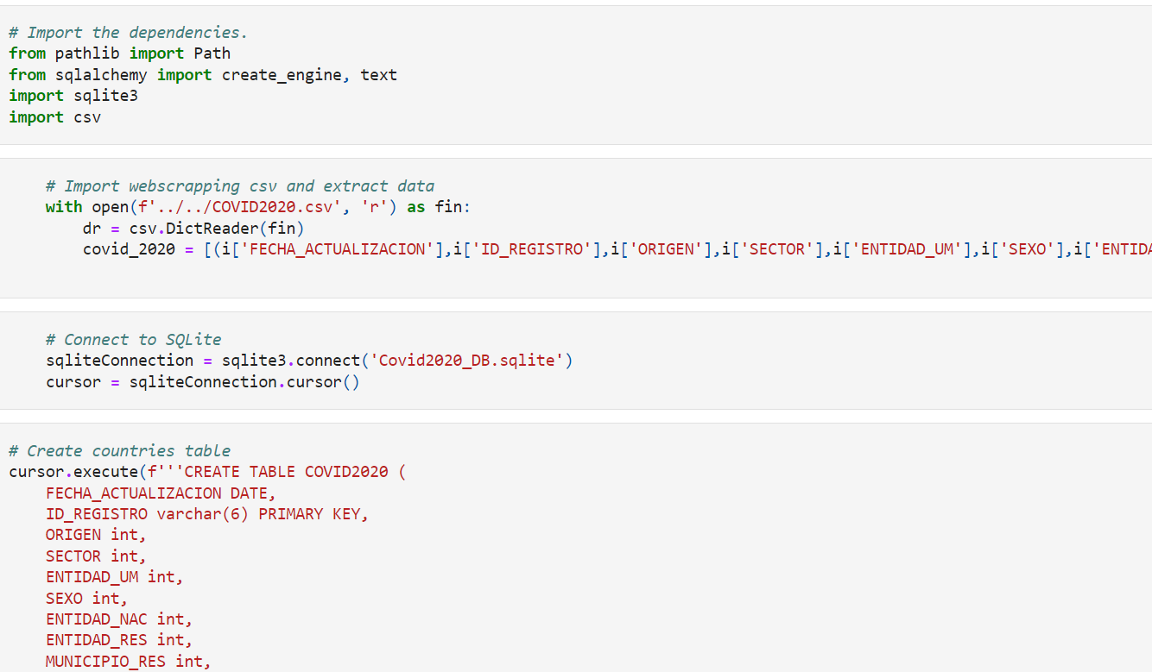
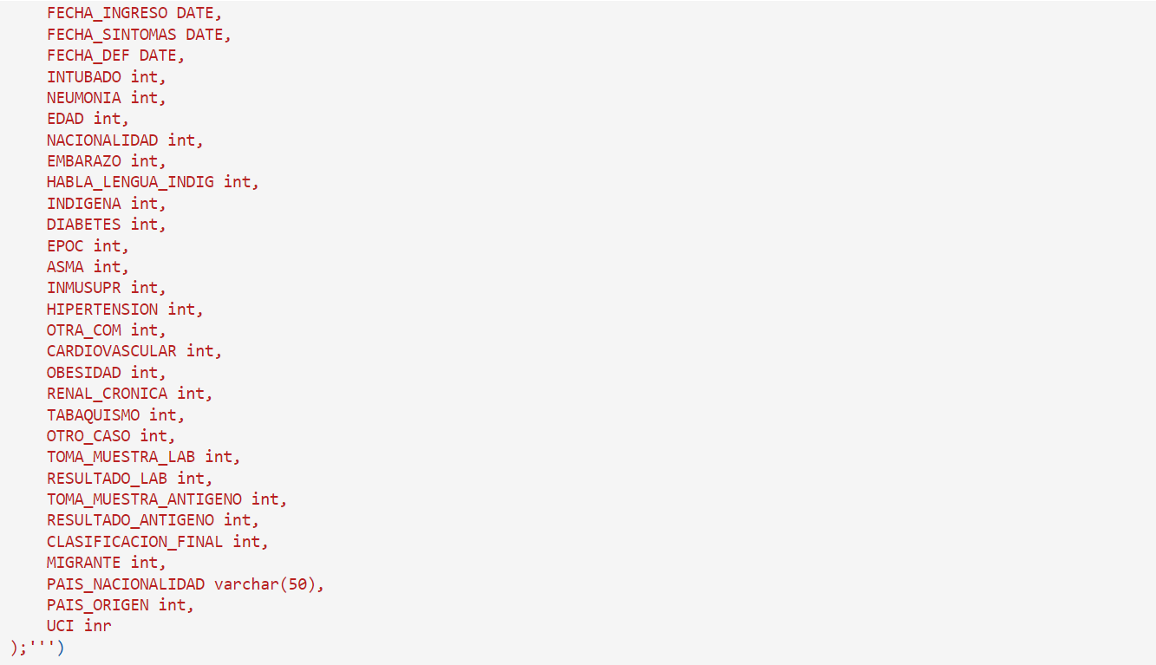
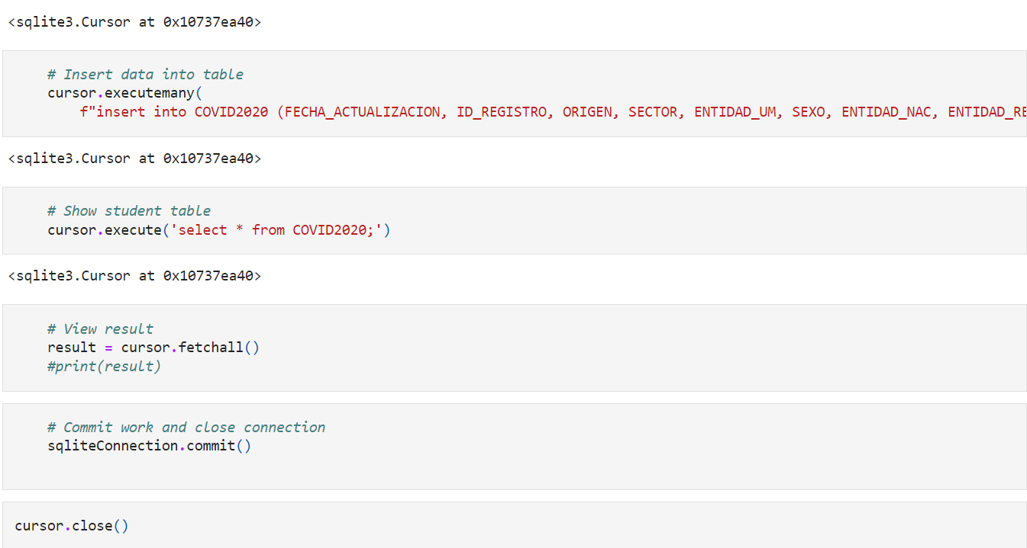
SQLite

Slide 13
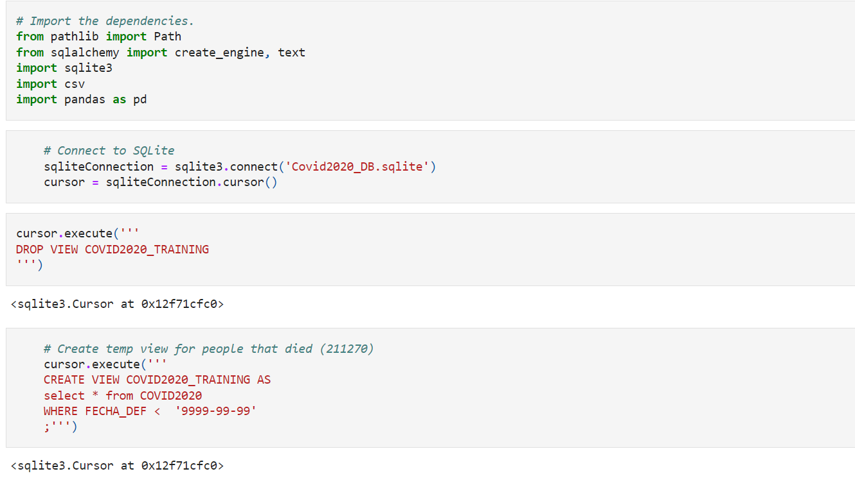
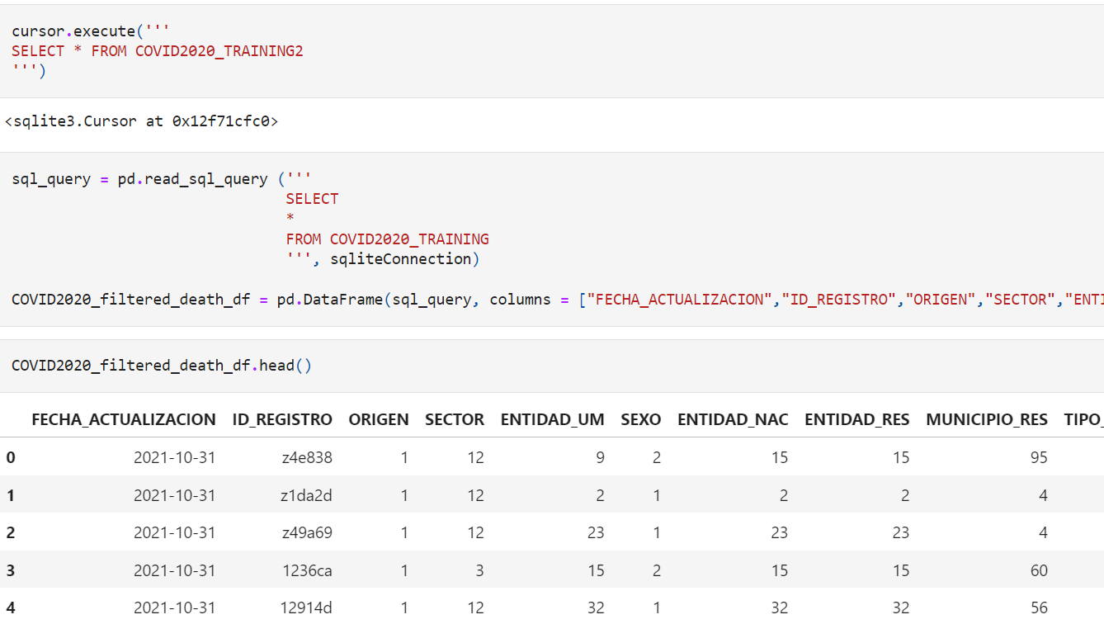
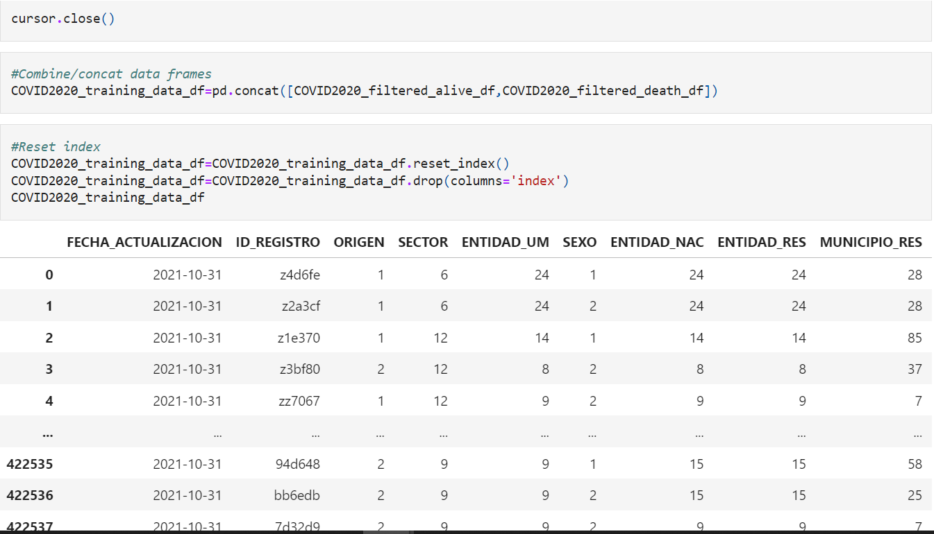
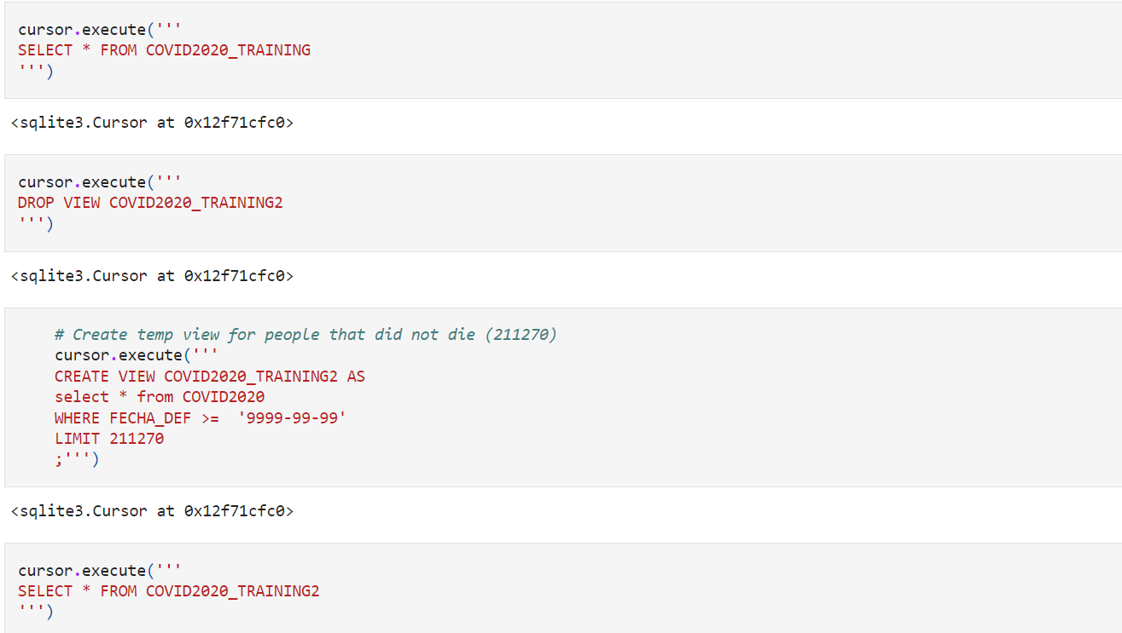
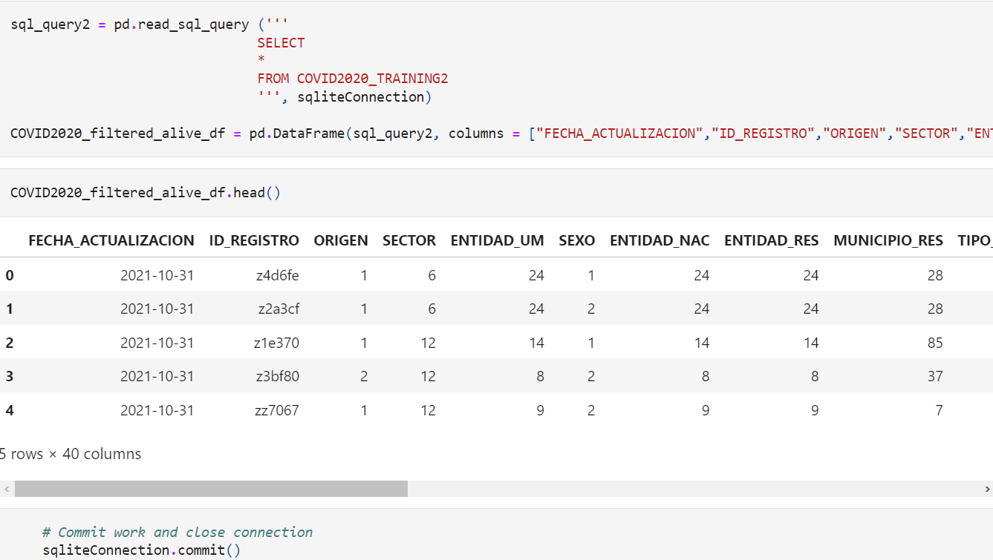
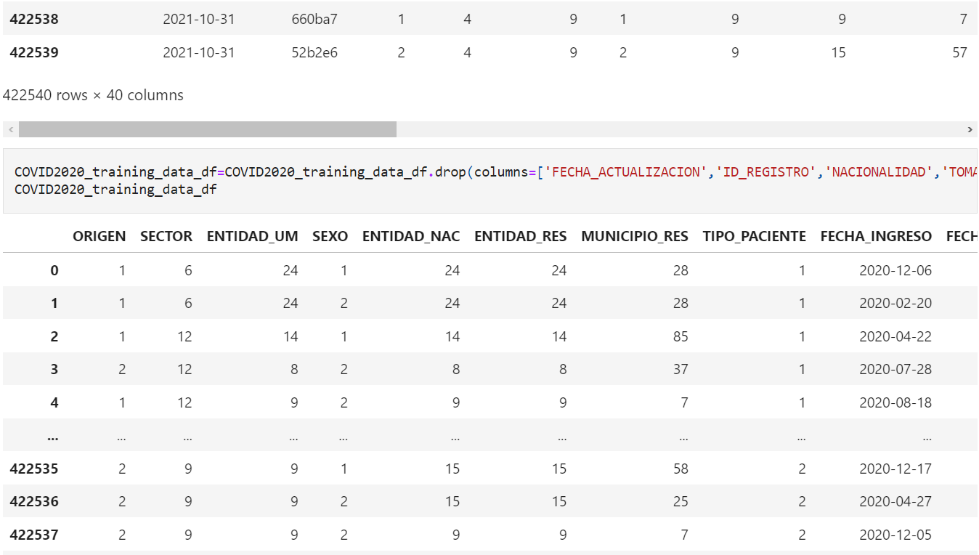
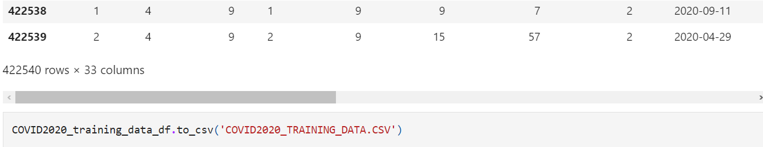
SQLite Search

Slide 14
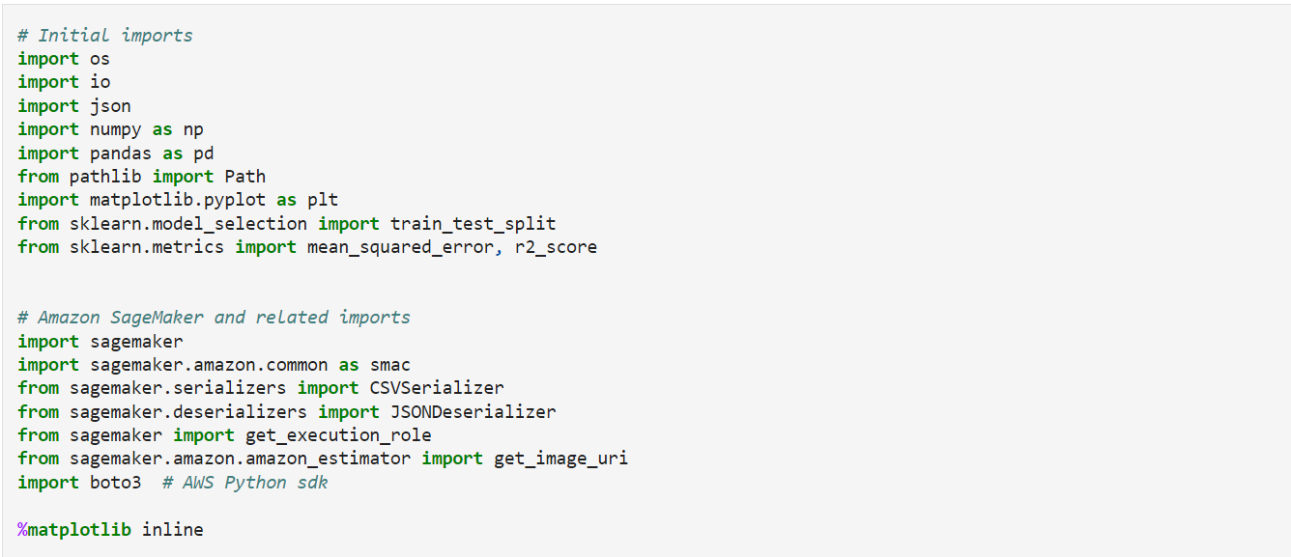
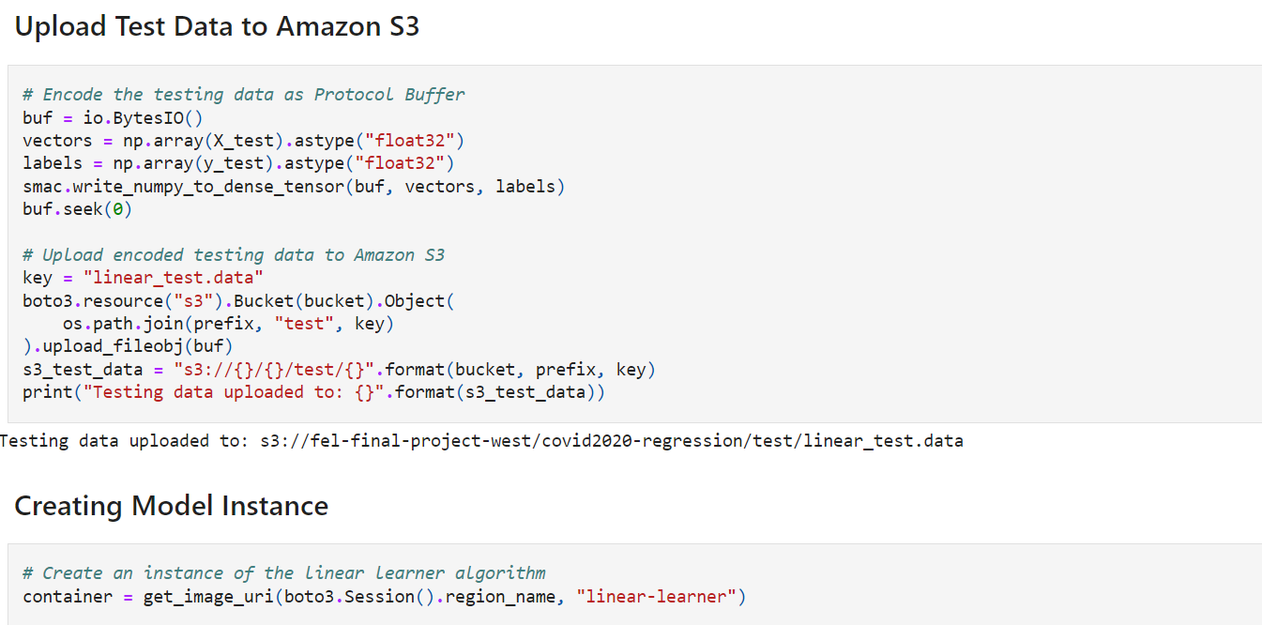
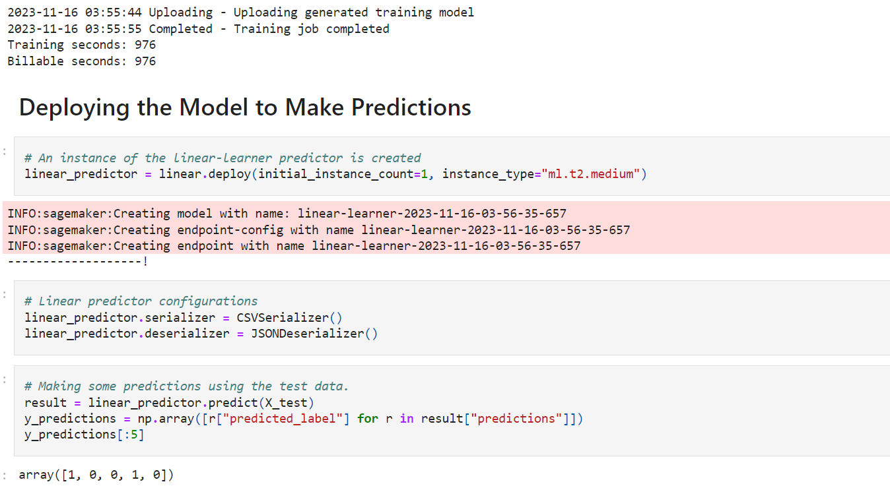
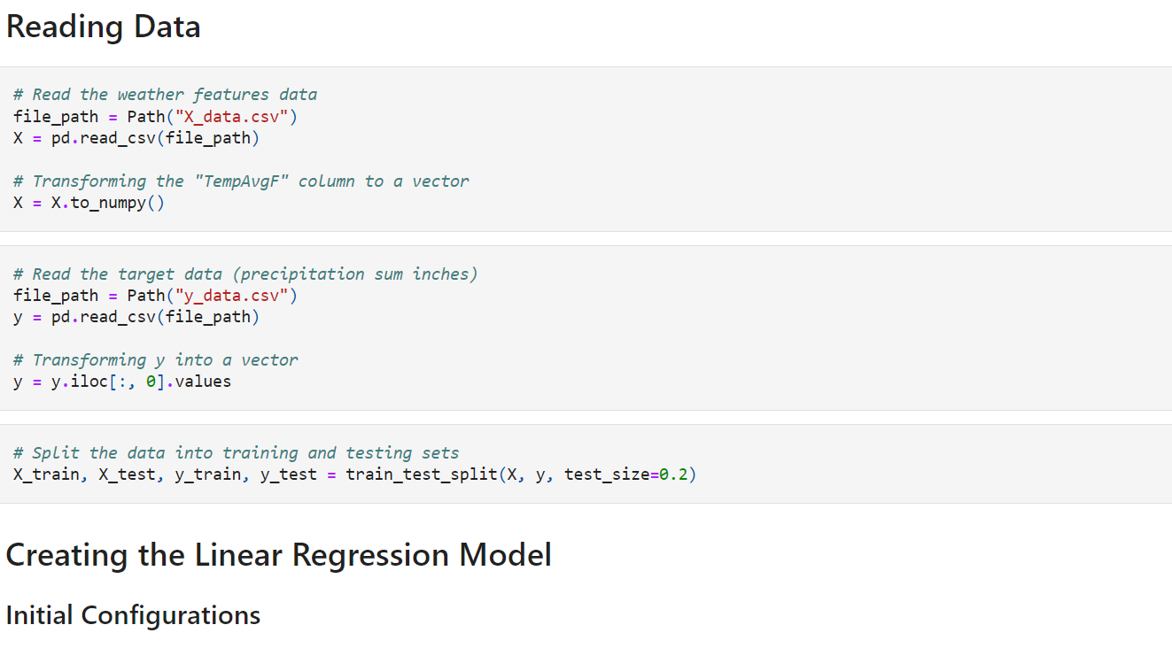
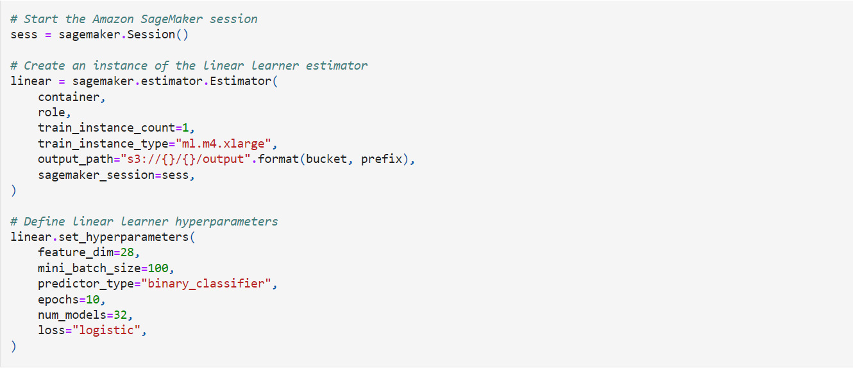
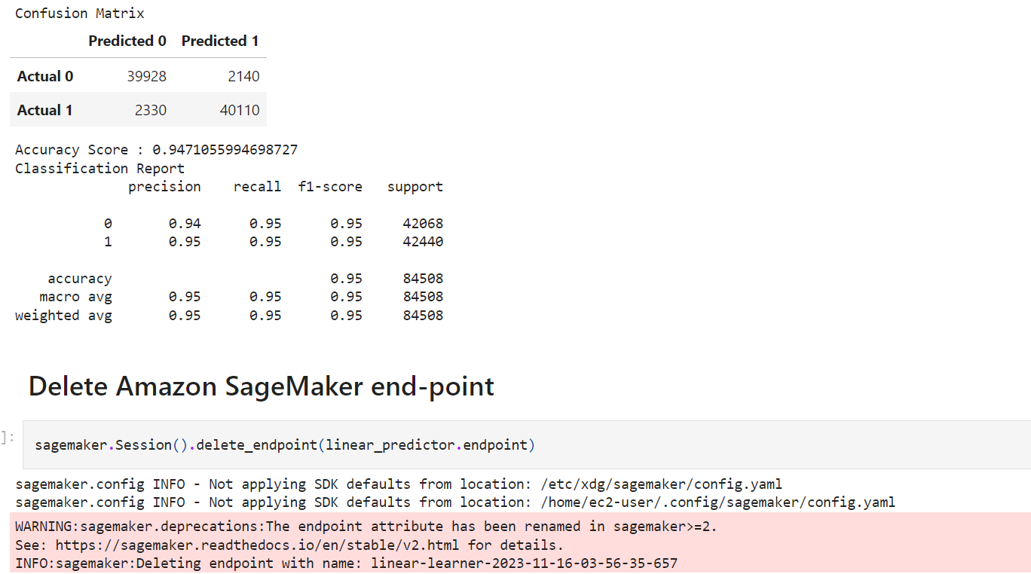
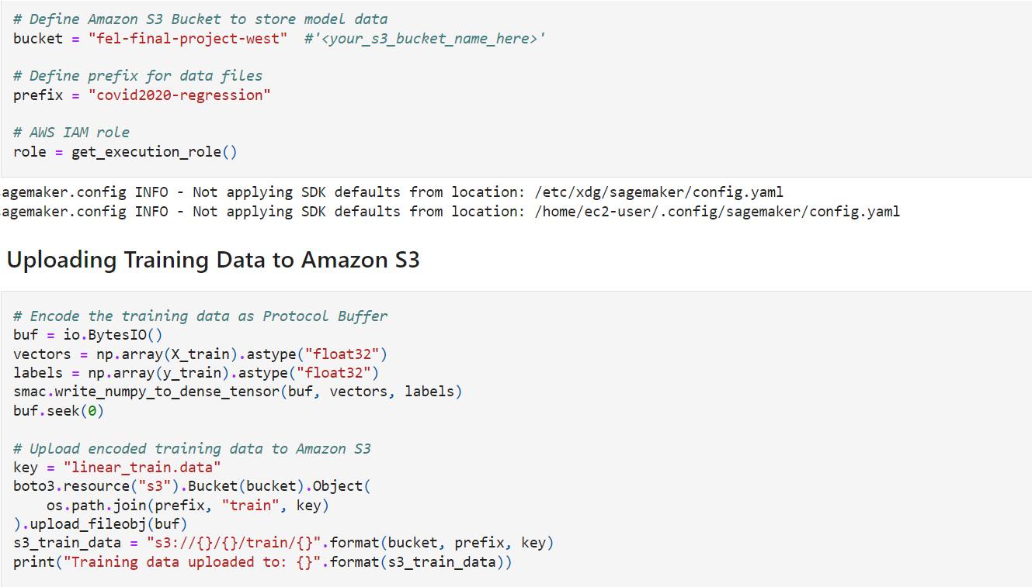
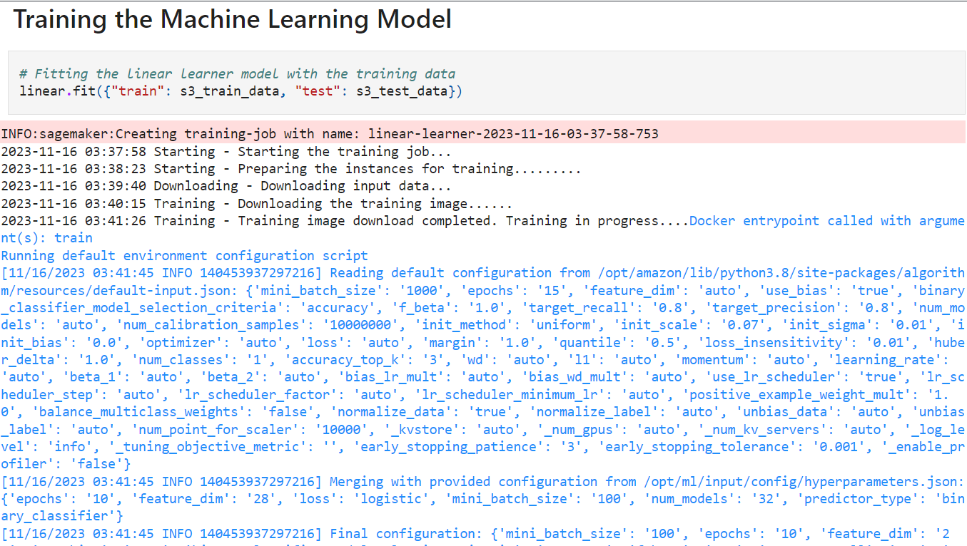
AWS - Logistic Regression

Slide 15
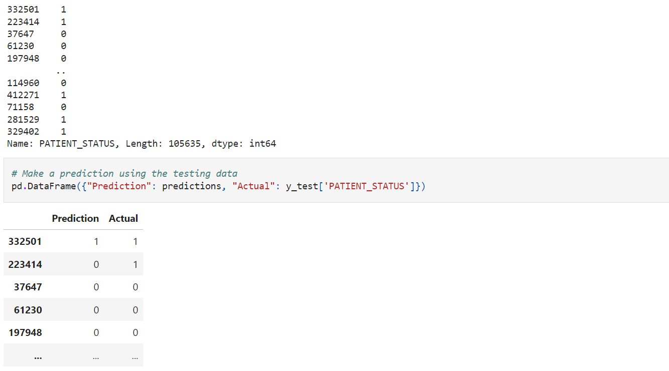
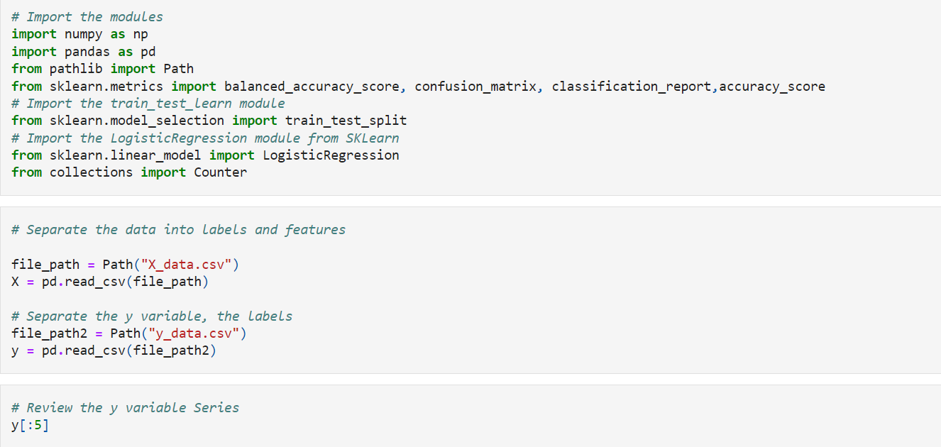
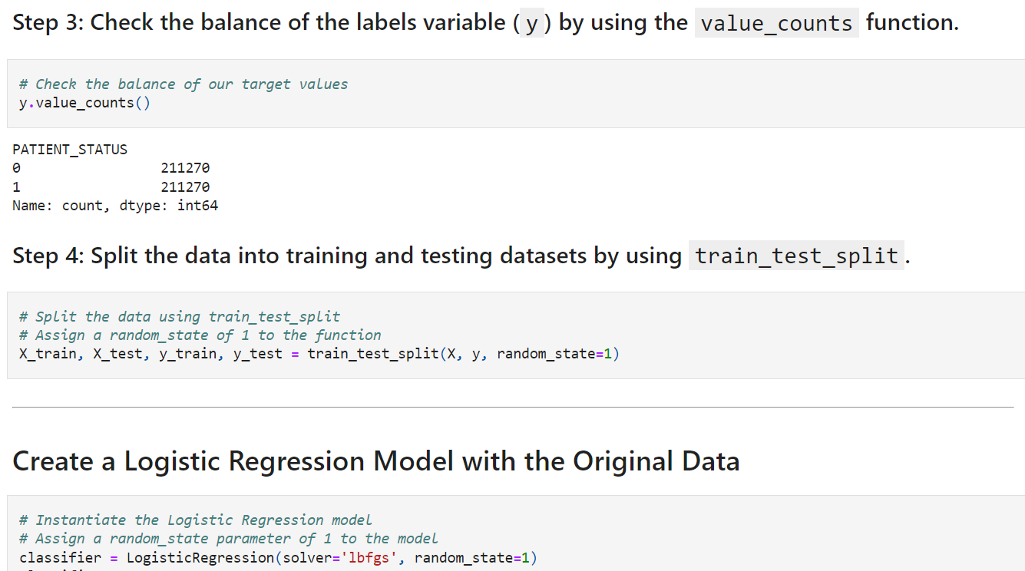
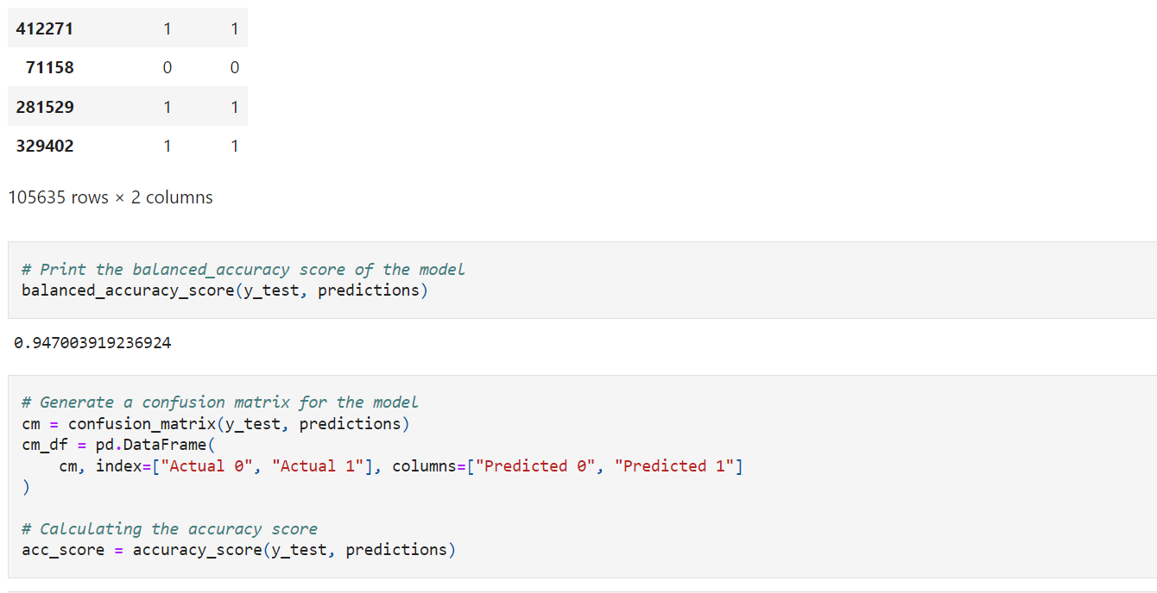
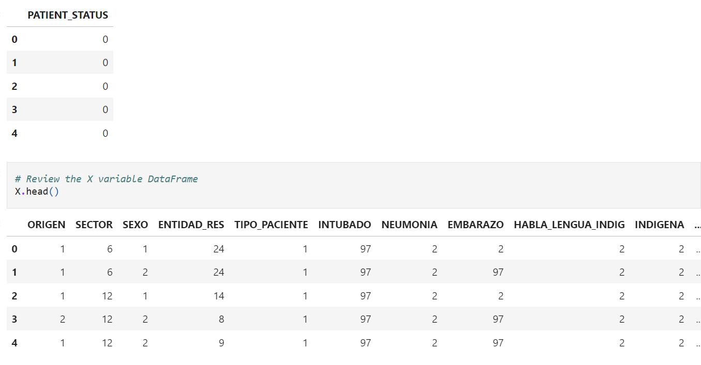
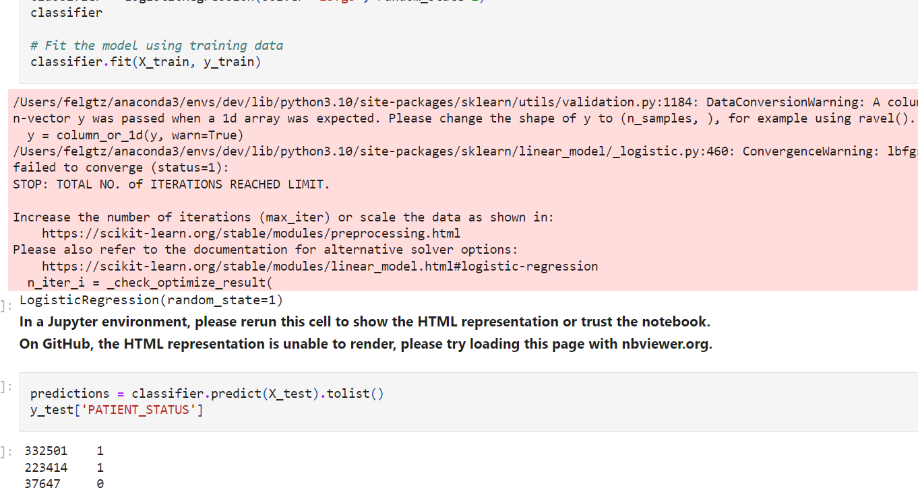
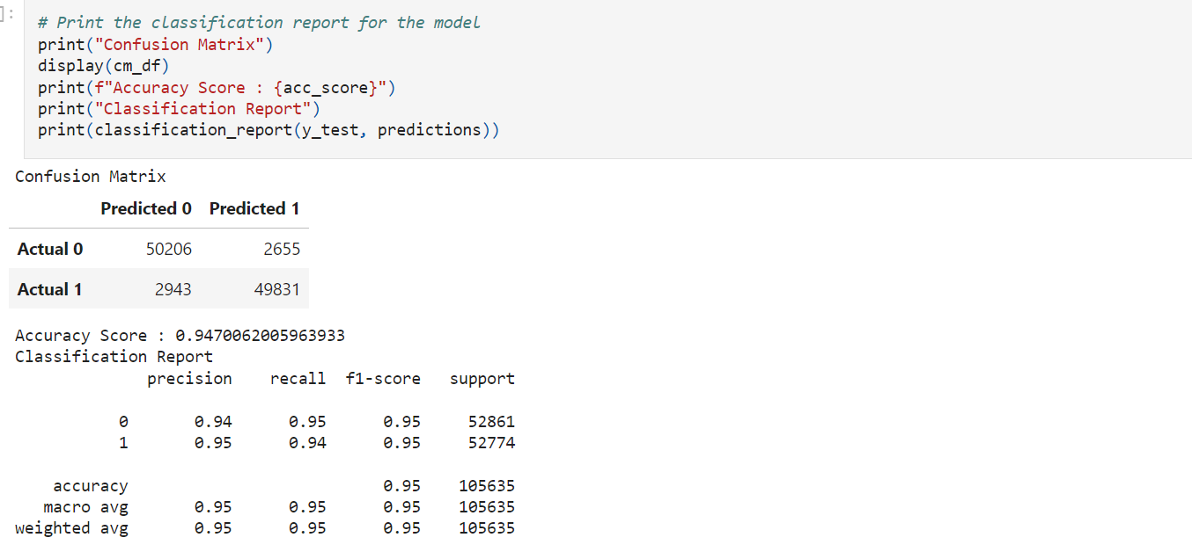
Logistic Regression

Slide 16
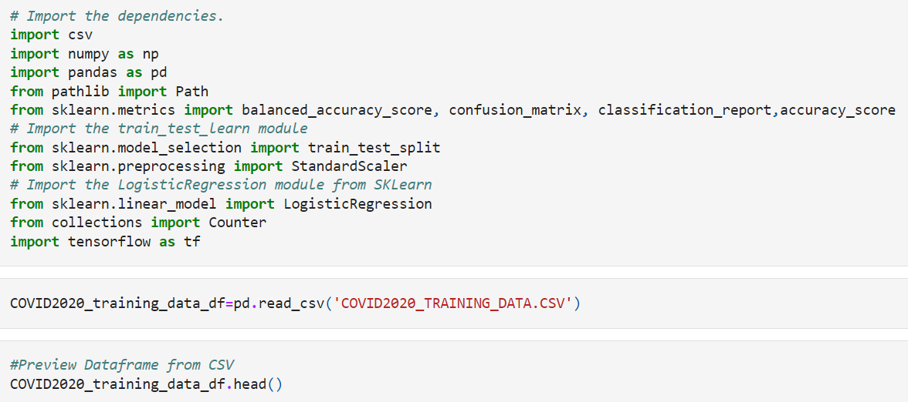
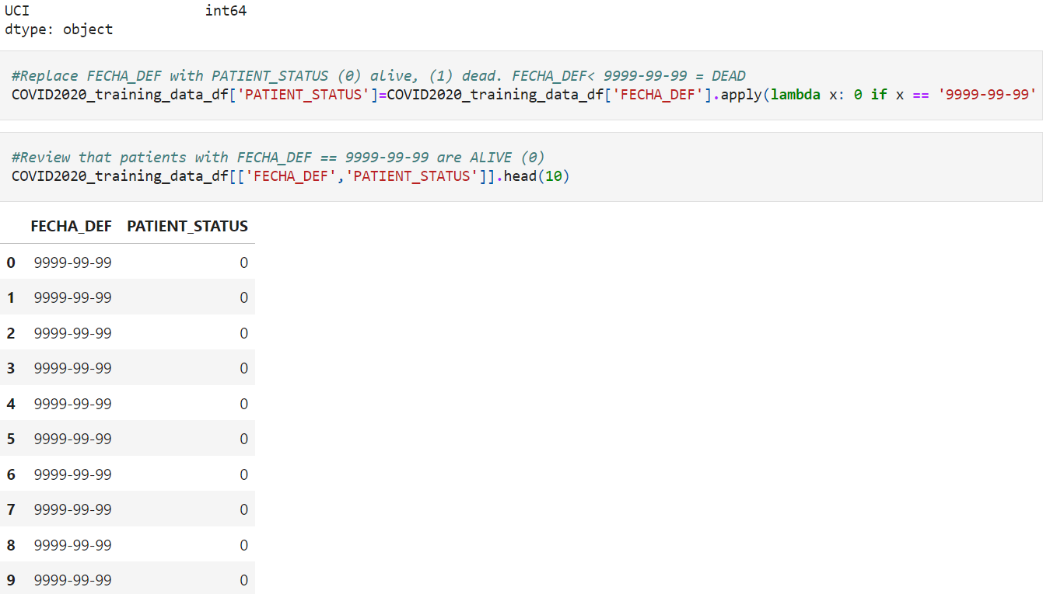
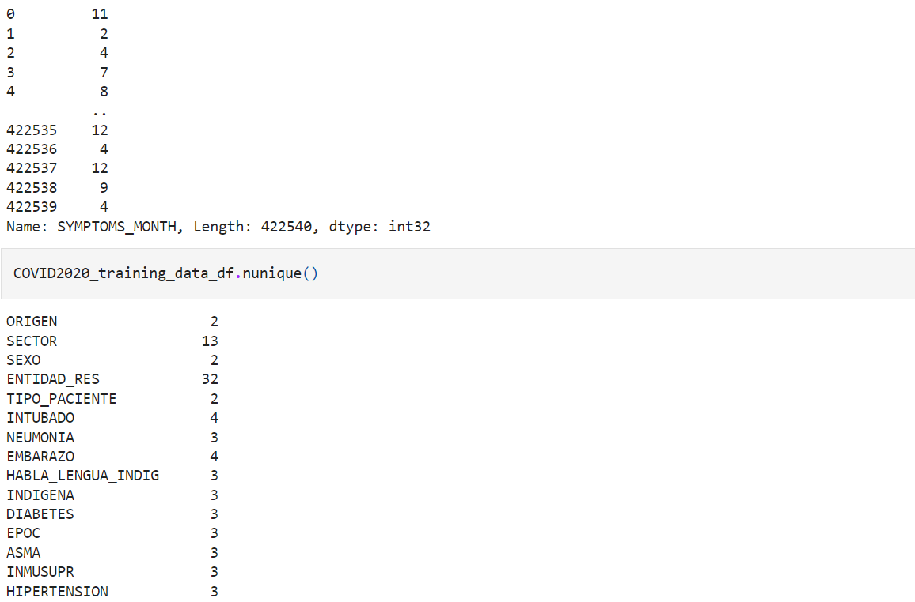
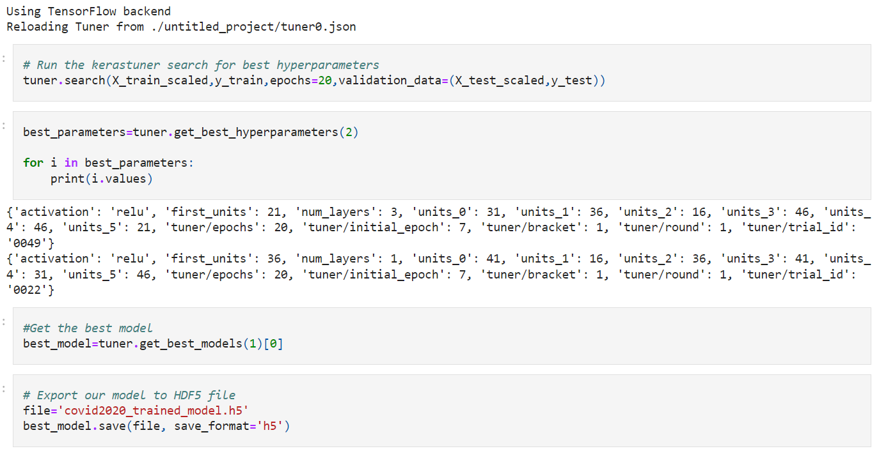
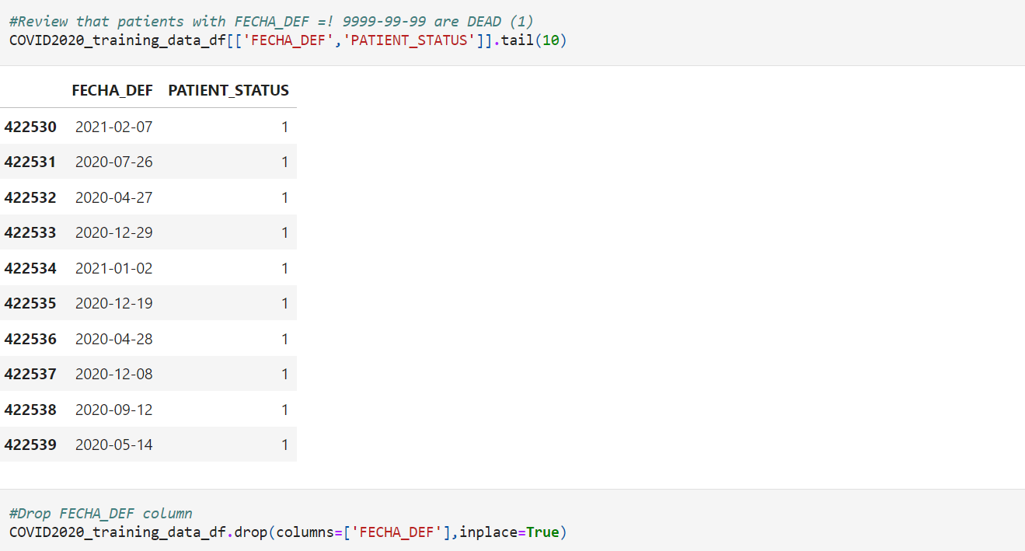
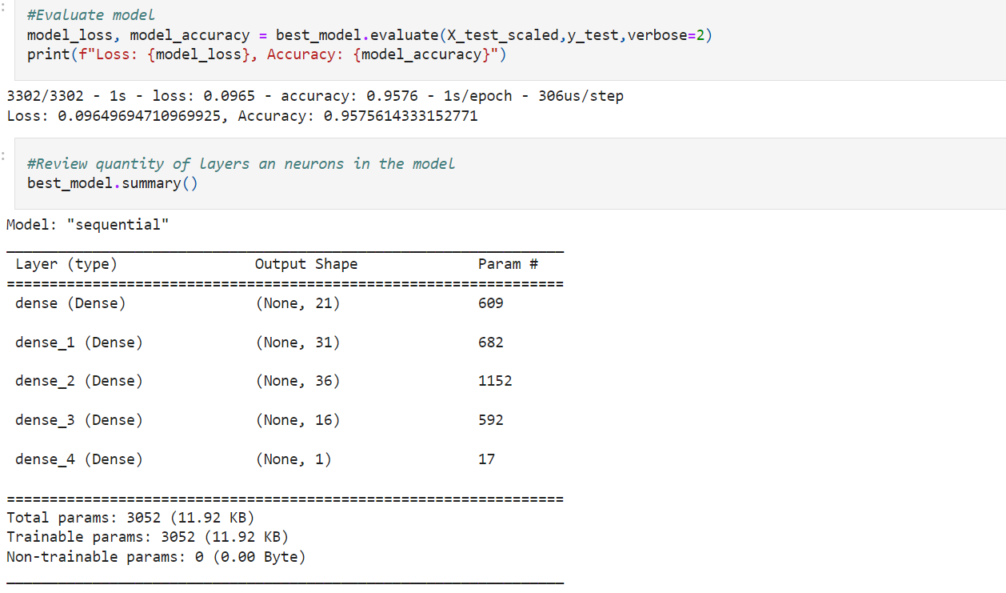
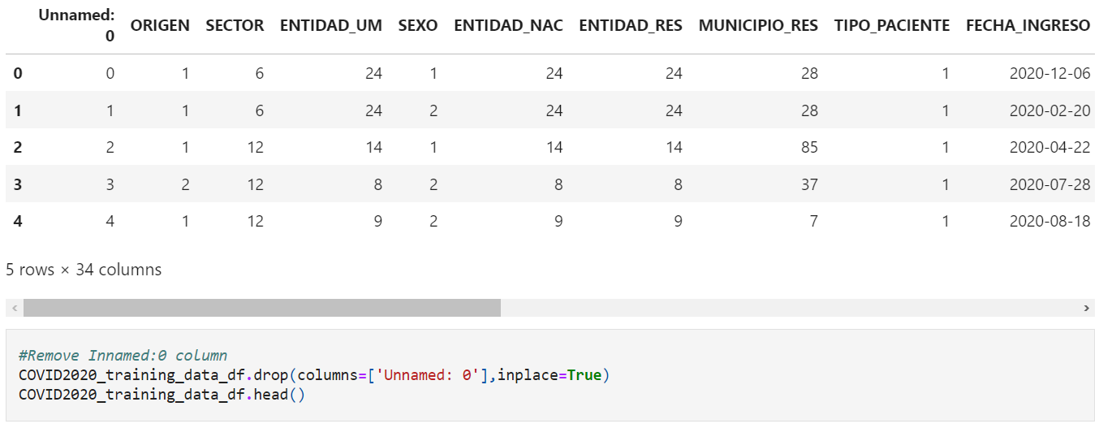
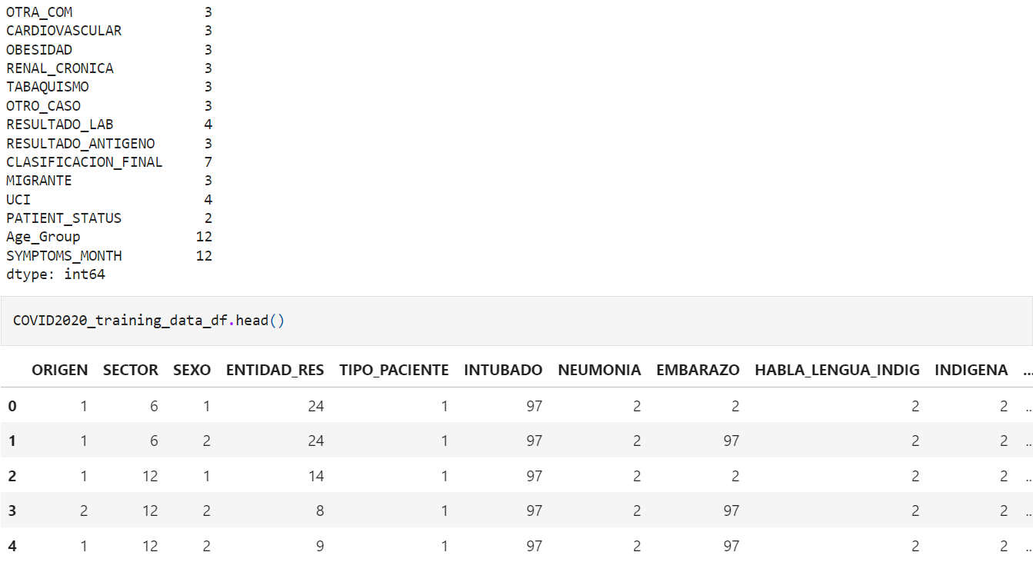
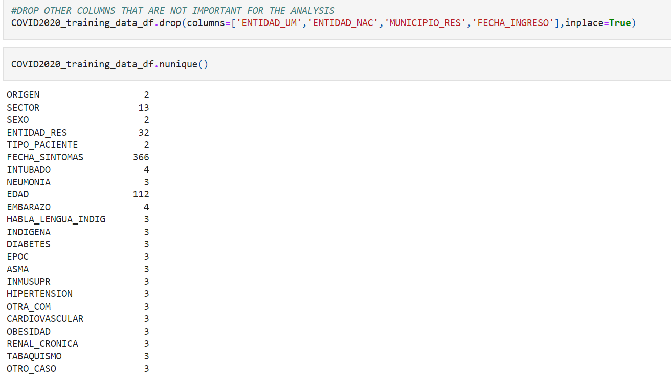
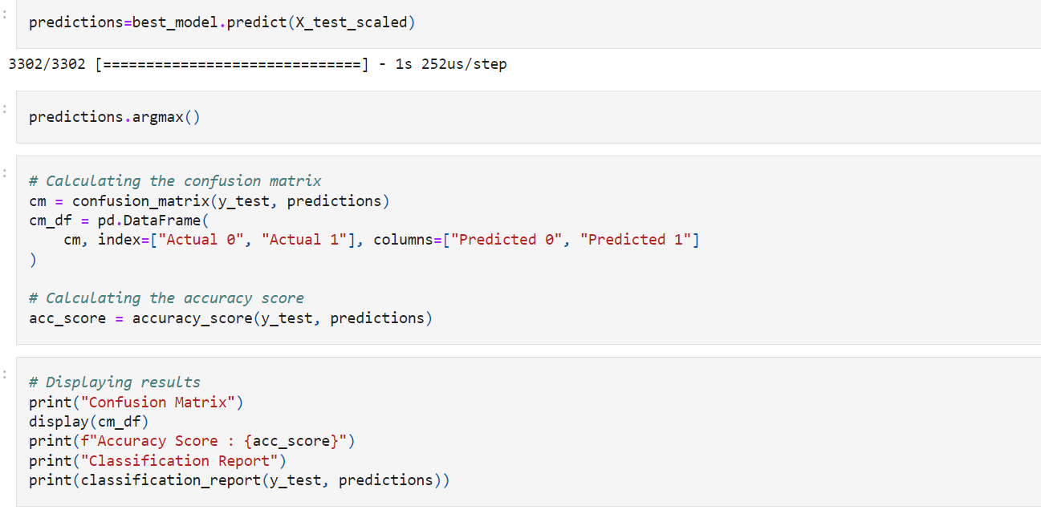
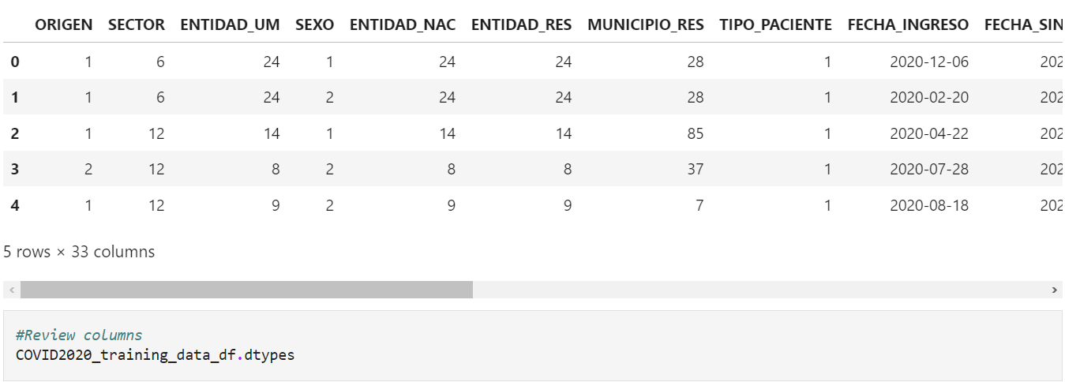
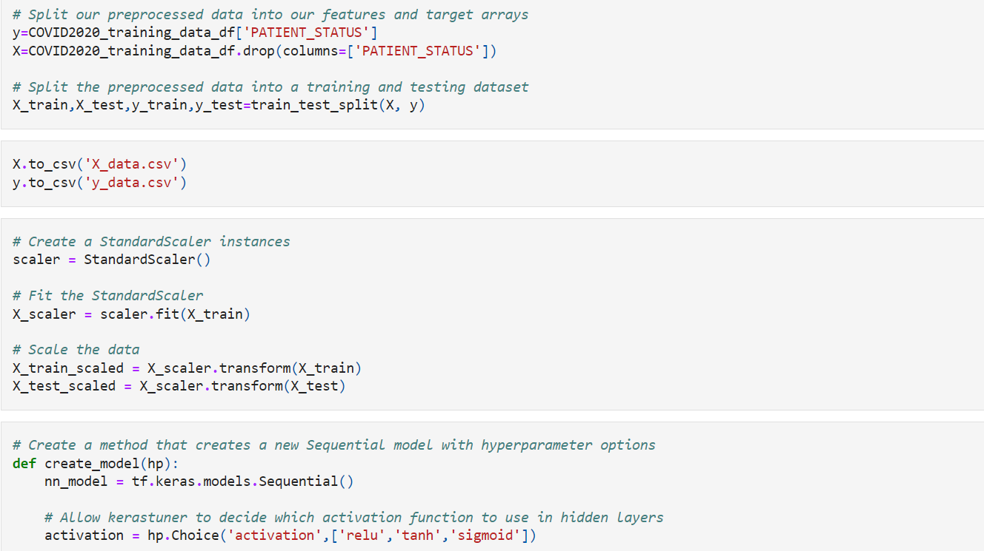
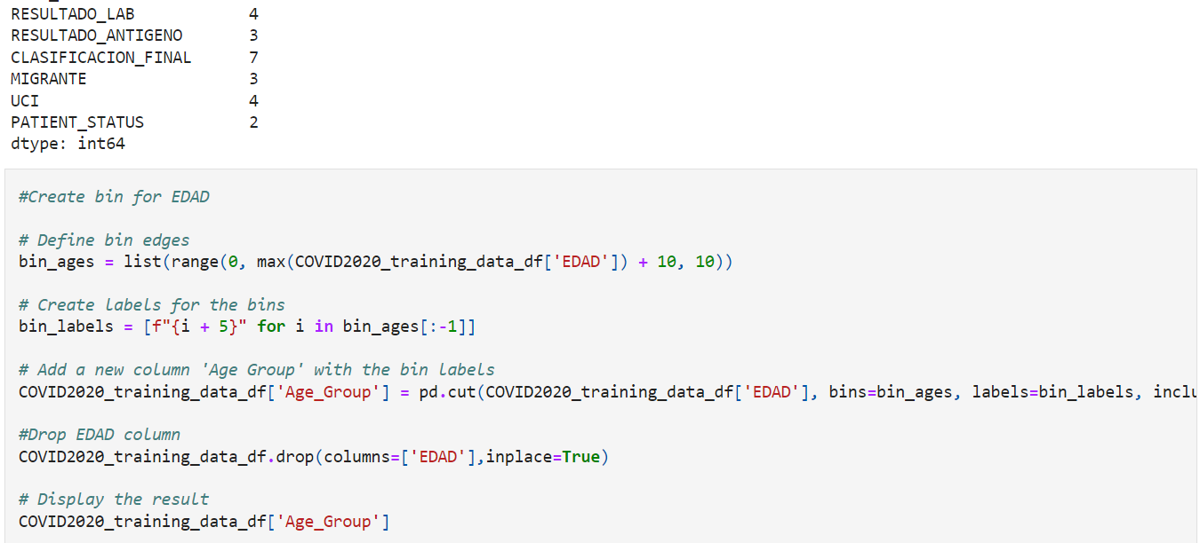
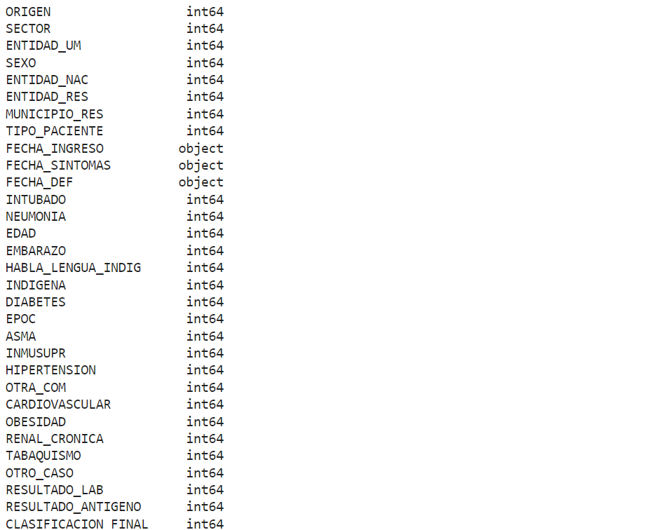
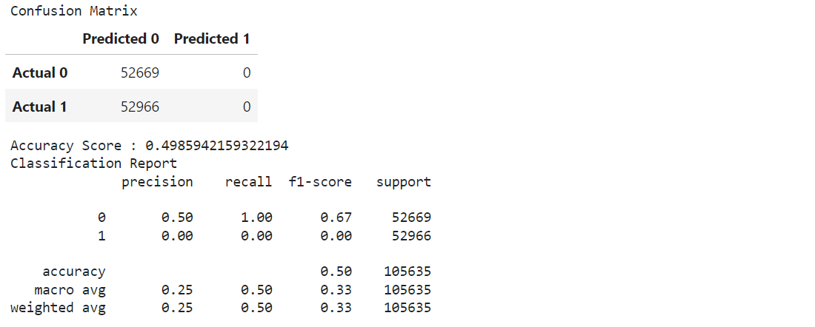
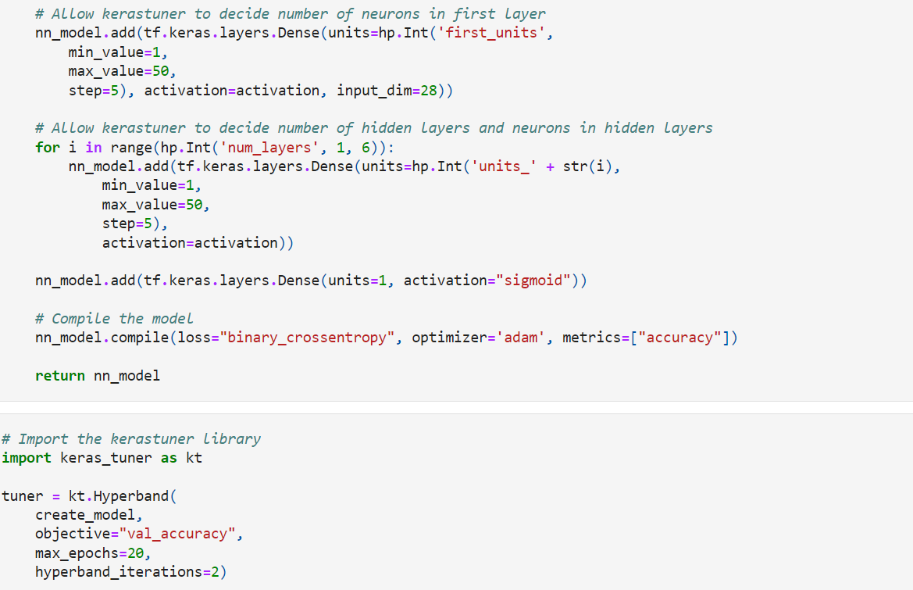
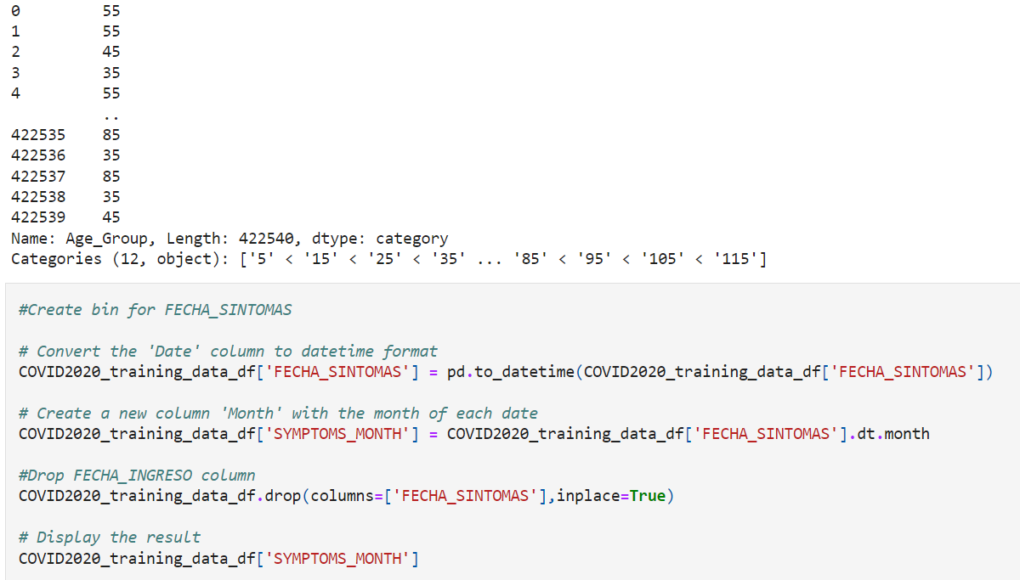
Neural Network

Slide 17
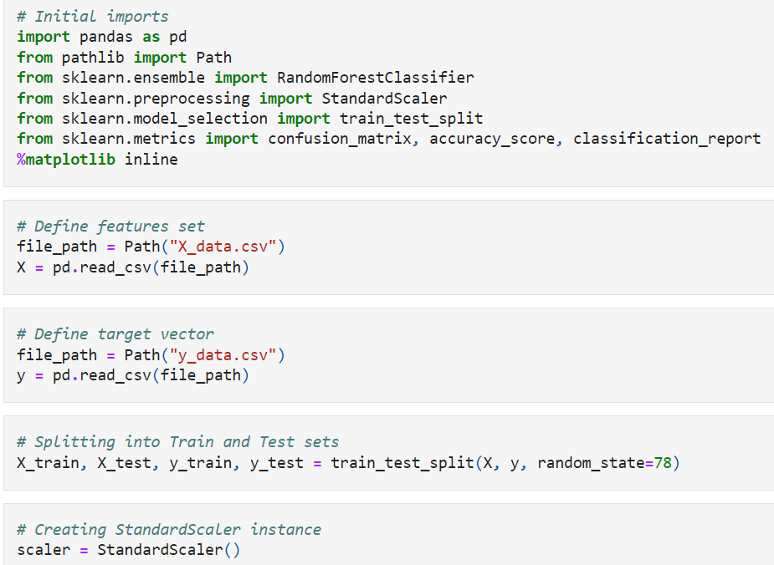
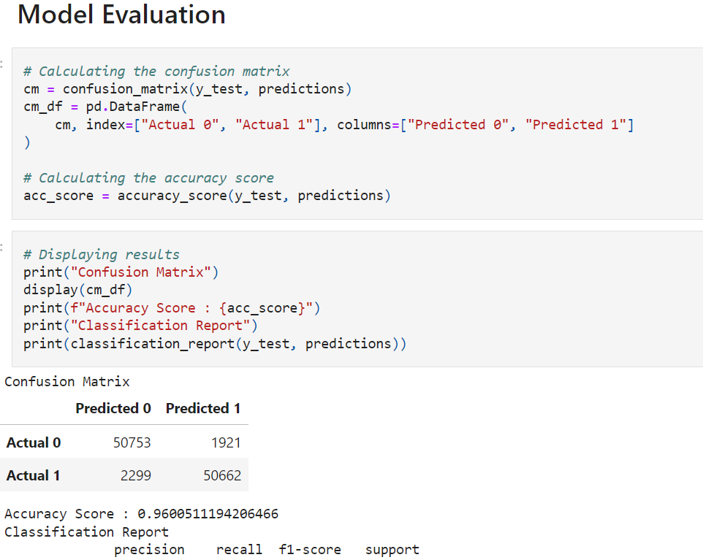
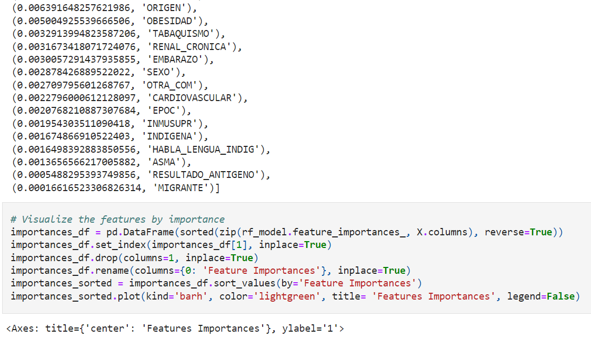
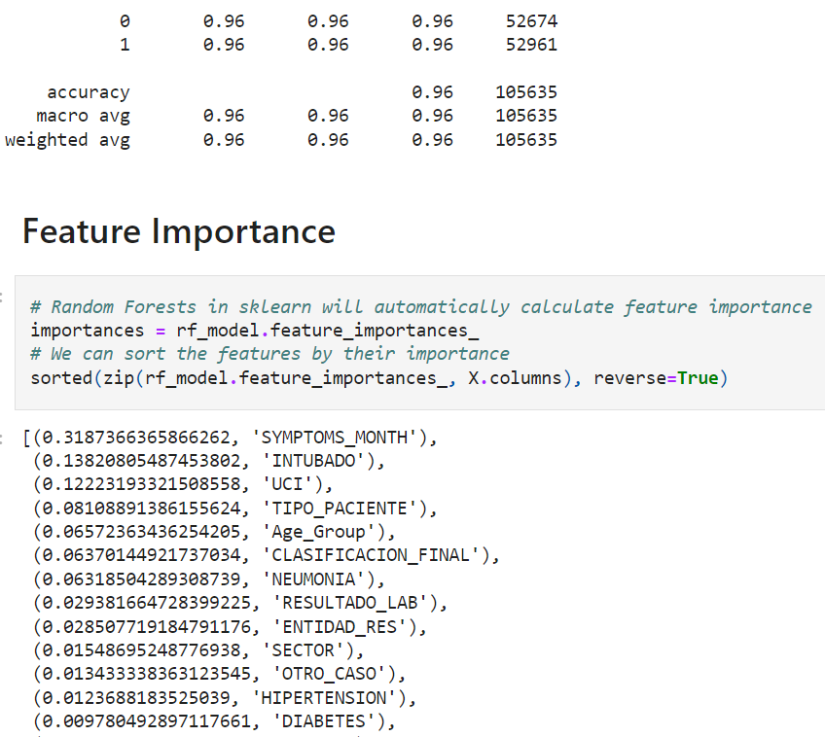
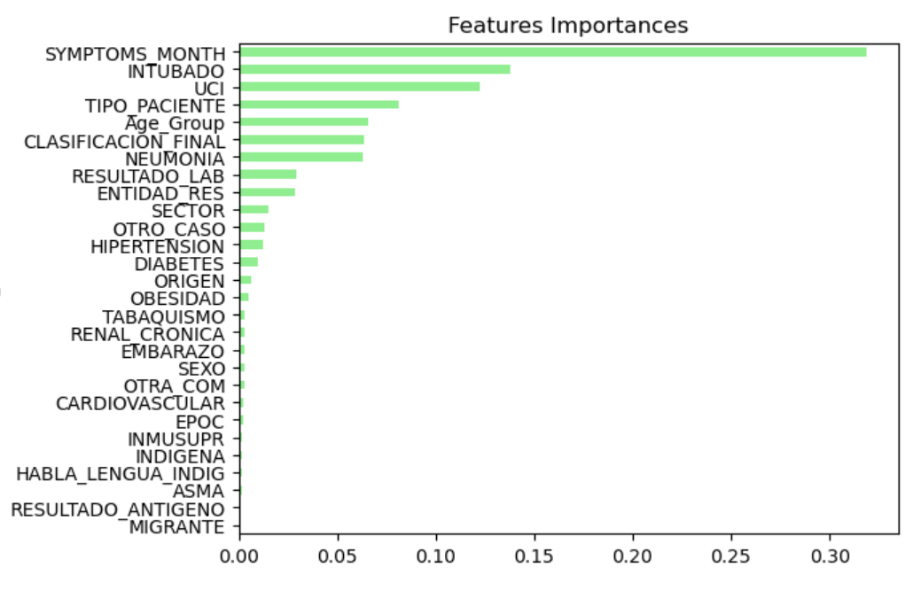
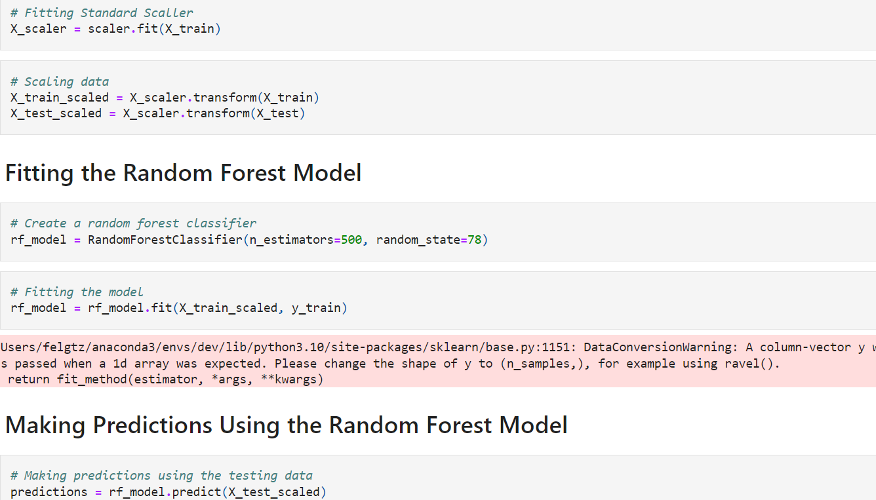
Random Forest

Slide 18
Graphs - Tableau
05

Slide 19
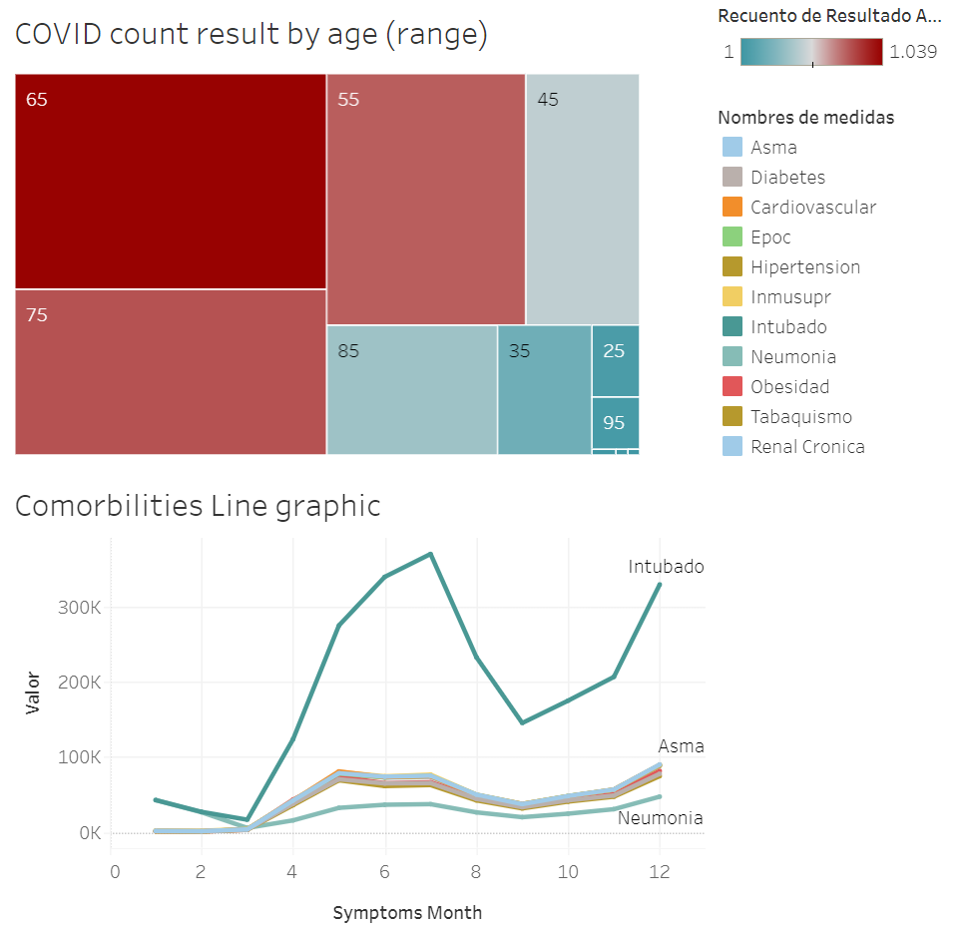
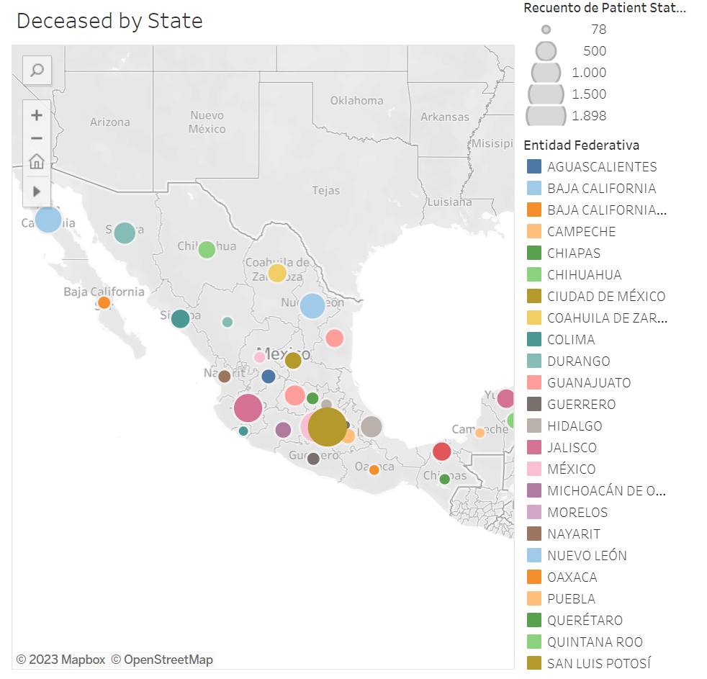

Slide 20




Morbidities & Age group VS Patient Status

Slide 21
06
Conclusion

Slide 22
Final Conclusions
The results obtained for each of the Tools used were the following:
Logistic regression: 94.70% accuracy
Neural Network: 95.81% accuracy
Random Forest: 96% accuracy
AWS (Logistic regression): 94.71% accuracy
The resulting model is considered successful and will let us know the probability of dying of COVID for a patient considering the eligibility in the parameters considered to build the model

Slide 23
Bibliography
Research
https://www.ncbi.nlm.nih.gov/pmc/articles/PMC10325129/#:~:text=Risk%20factors%20that%20contribute%20to,and%20a%20history%20of%20smoking.
Photos
Doctor taking coronavirus test sample
Front view of medical control for covid19 concept
People in protective equipment disinfecting a dangerous area
Person wearing protective equipment with copy space
Woman wearing a medical protective equipment

